Slide 1

FRONTEND DEVELOPMENT
LMS Project Implementation Report
A comprehensive overview of module development and frontend architecture by Ajay, Frontend Developer
Reporting Period: January 22, 2026

Slide 2

Project Overview
Scope
Integration Status
Frontend Completion
Seven major LMS modules designed and implemented with modern React architecture
Course & Content modules fully integrated with backend APIs
All remaining modules frontend-complete with API-ready structure

Slide 3

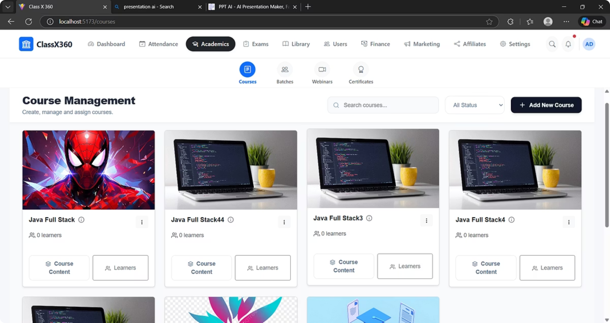
COMPLETED
Course & Batch Management
Key Features
Status
Complete CRUD operations via REST APIs
Backend Integration: Complete
Unified content handling for videos and PDFs
Content Types: Video, PDF, and mixed media support
Structured course overview with intuitive navigation
API Coverage: 100%
Robust service layer architecture
Notes:
the image which i gven it cutting ppt

Slide 4

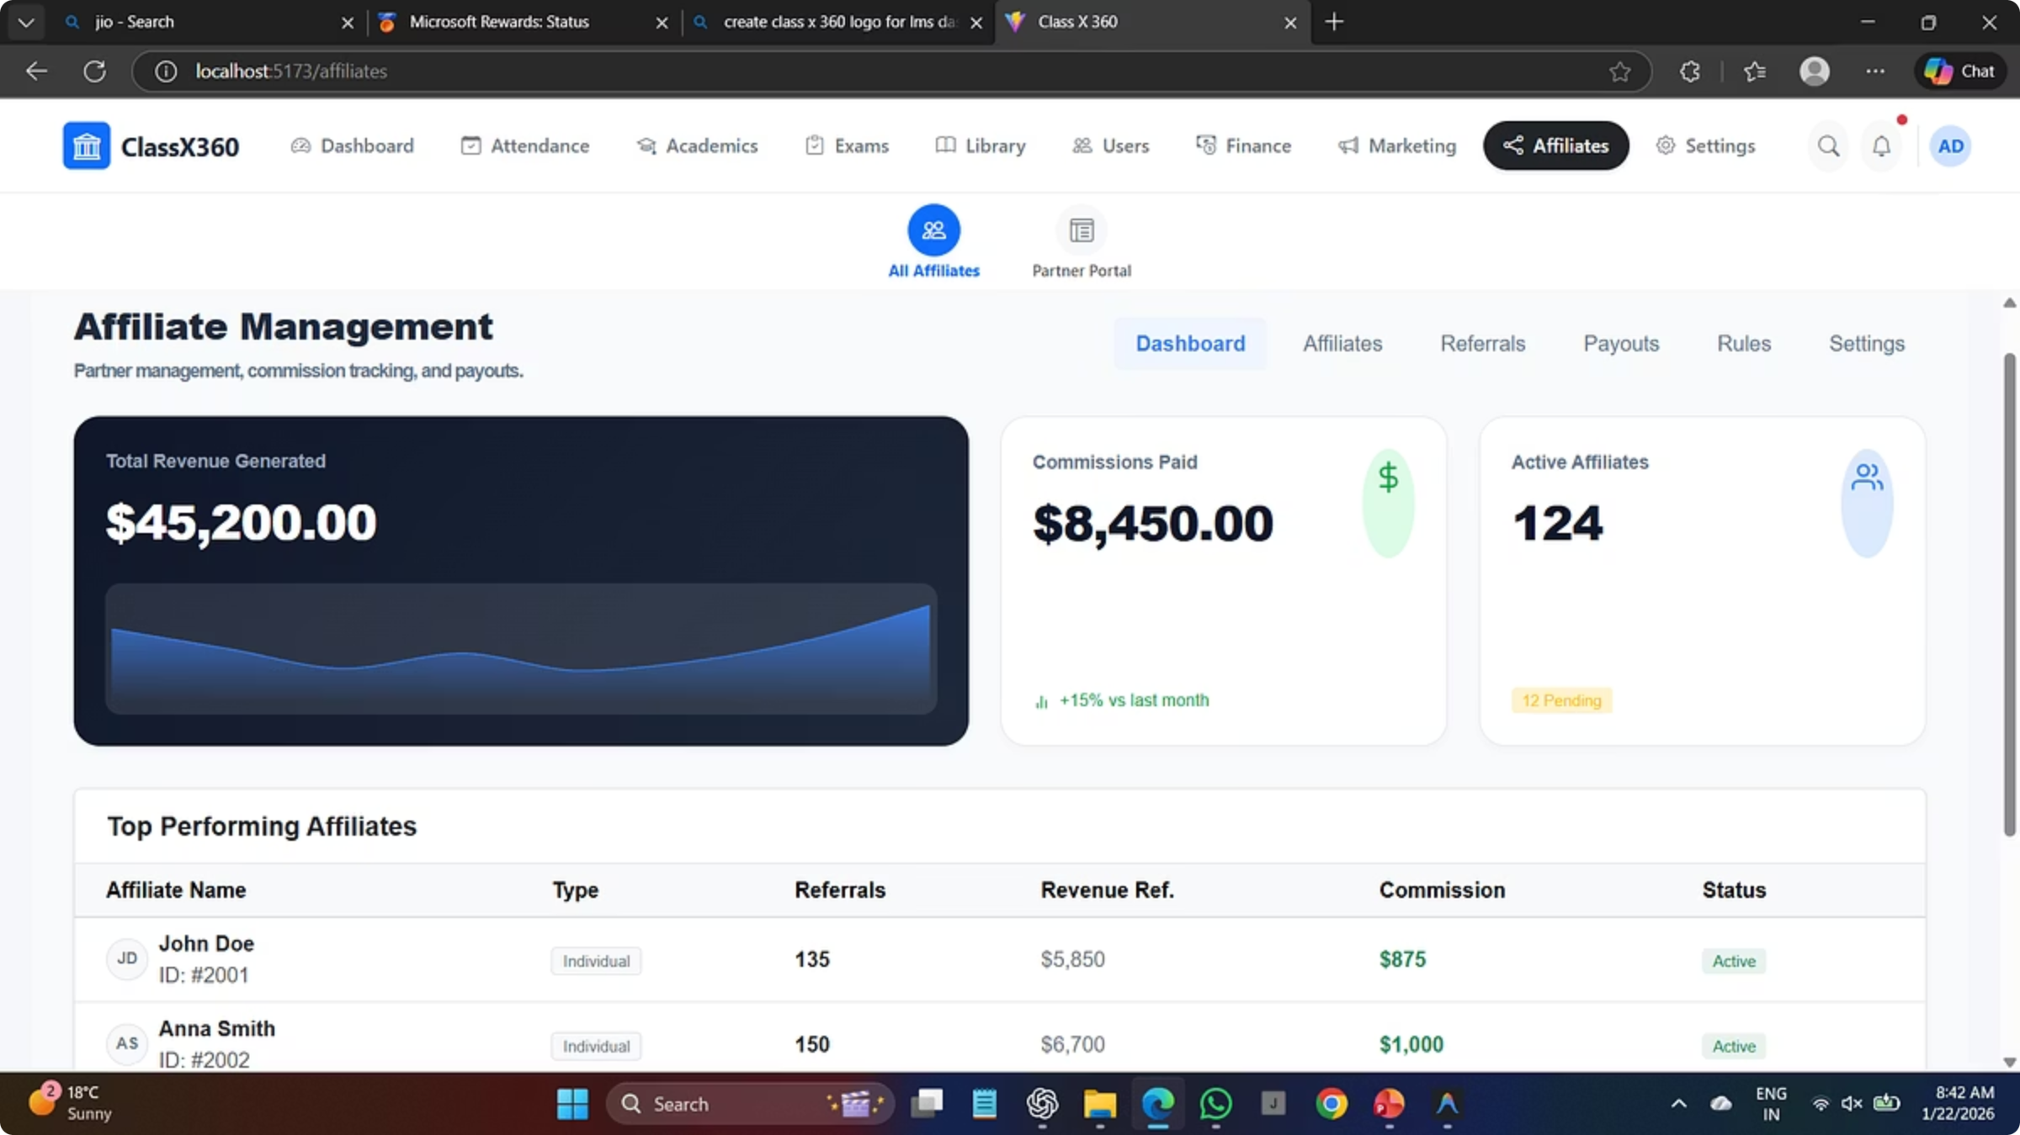
PARTIALLY COMPLETE
Affiliate Marketing Module
Admin-side frontend implementation with core workflows established and ready for backend integration
01
Affiliate Dashboard
Comprehensive UI for affiliate performance tracking and metrics visualization
02
Registration Flow
Streamlined onboarding process with multi-step validation
03
Admin Management
Complete administrative screens for affiliate oversight and approval
04
Commission System
UI framework with mocked commission tracking and payout interfaces

Slide 5
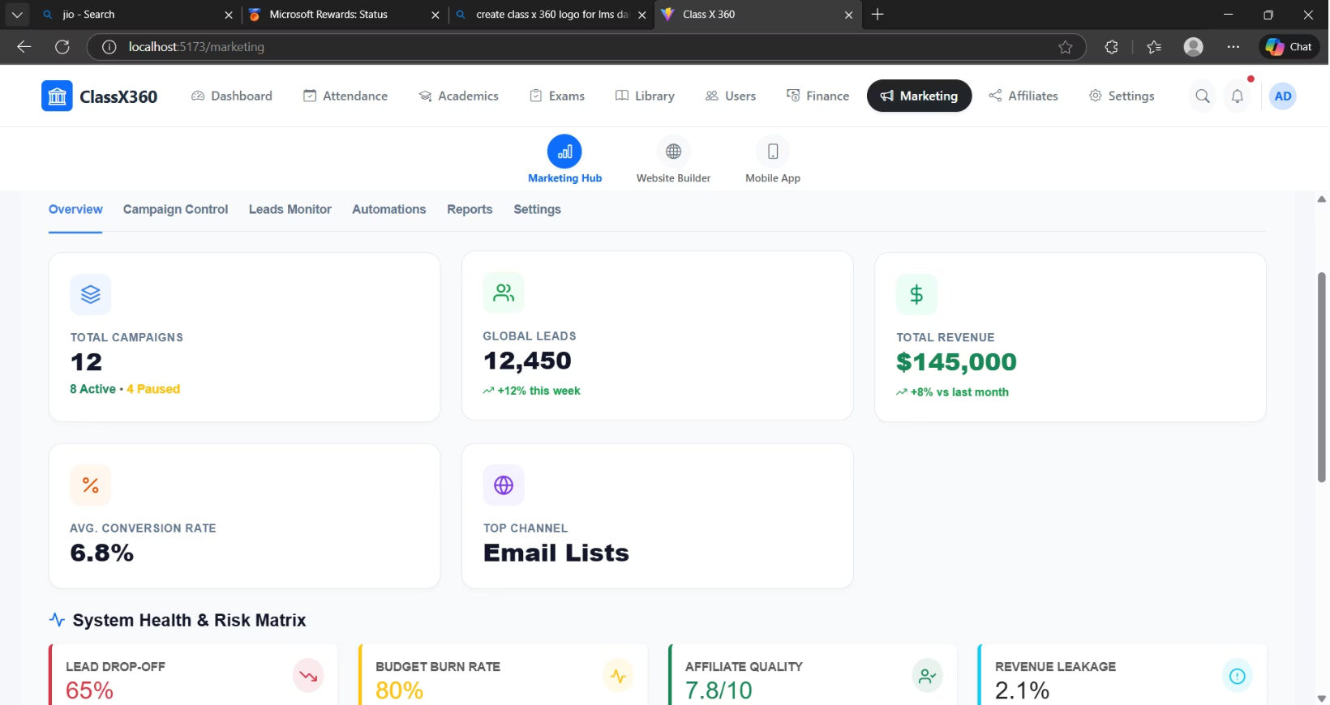
INITIAL IMPLEMENTATION
Marketing Hub
Admin-side frontend implemented at foundational level. Additional requirements clarification needed for advanced features and workflow enhancements.
Implemented Features
Role-based UI framework
Campaign creation and management interfaces
Lead tracking dashboard with filtering
Analytics charts with mocked datasets

Slide 6
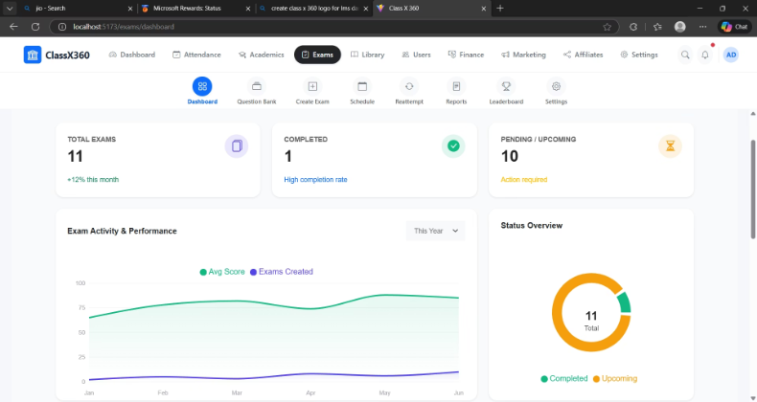
Exam Module
Admin Dashboard
PARTIALLY COMPLETE
Exam Creation
Intuitive interface for building exams with multiple question types and time
limits
Student Interface
Clean, distraction-free exam-taking experience with auto-save functionality
Admin Dashboard
Comprehensive oversight of all exam activities, scheduling, and student progress
Results & Analytics
Detailed performance metrics and statistical analysis dashboards

Slide 7
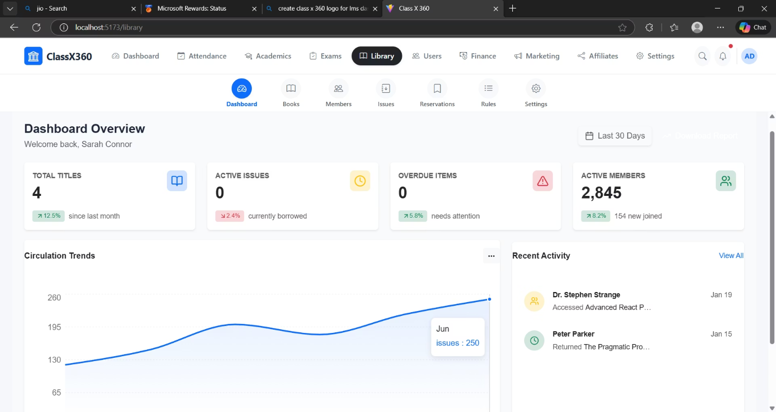
PARTIALLY COMPLETE
Library Management
Admin-side frontend with core library workflows ready for backend integration
Key Components
Integrated library dashboard with real-time inventory status
Book issue and return workflow management
Advanced search with filters and categorization
Admin-based views for collection management

Slide 8
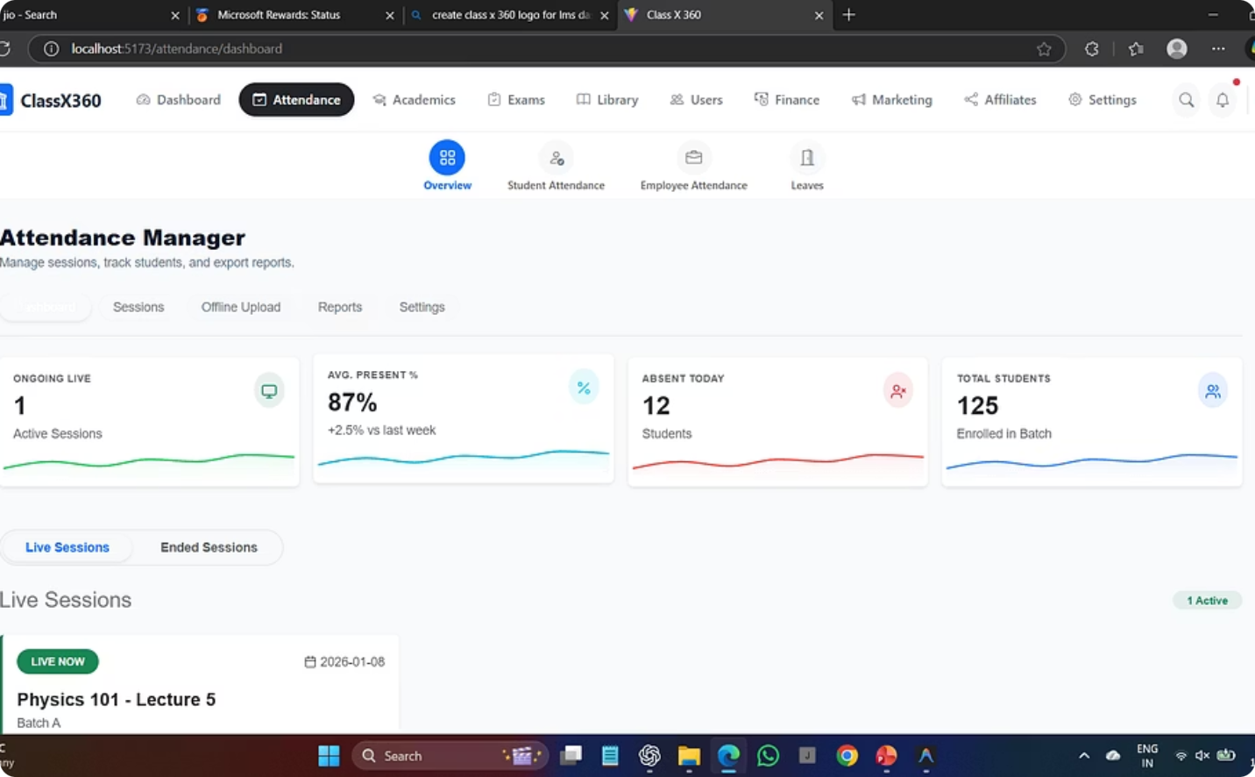
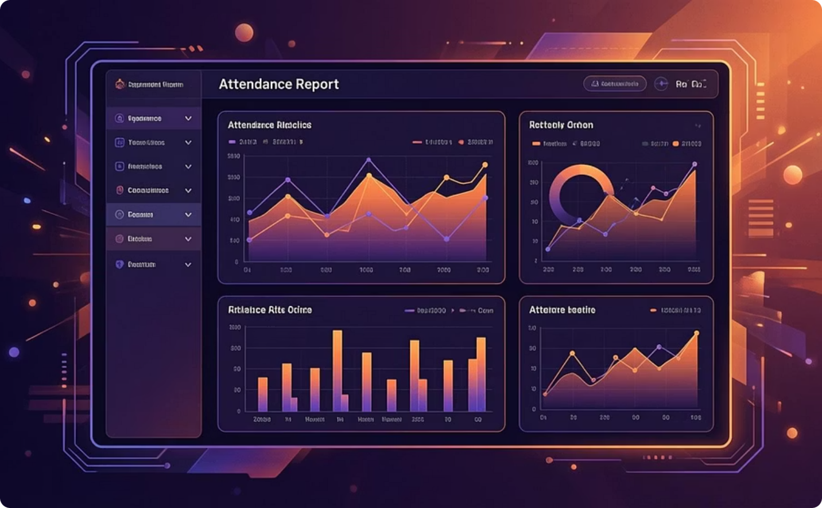
FRONTEND COMPLETE
Attendance Module
Comprehensive attendance tracking system with admin-focused dashboard featuring summary metrics and session management capabilities
Session Tracking
Reporting Interface
Live and completed session monitoring with attendance rates
Comprehensive reports with offline upload capabilities
Supports both student and employee attendance with role-specific views

Slide 9
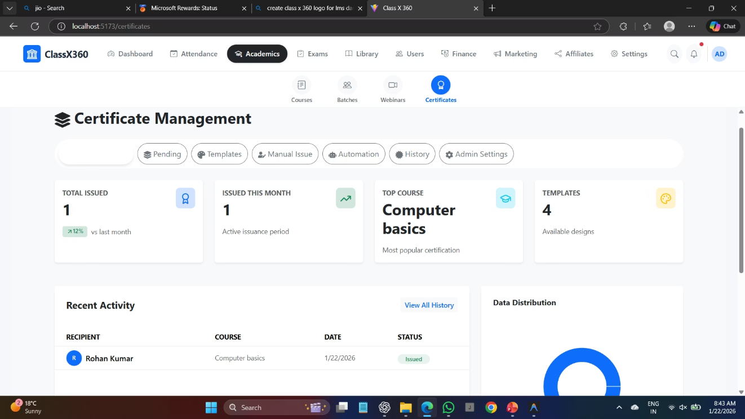
ACADEMIC MODULE
Academic Management System
Attendance Integration
Seamless tracking UI connected to student performance metrics
Batch Management
Complete batch creation, student allocation, and scheduling workflows
Certificate Generation
Automated certificate creation UI with customizable templates
User Roles
Granular role management with permission-based access control
Exam & Reports
Integrated exam creation with comprehensive report tracking

Slide 10









Technical Architecture
React Framework
Redux State Management
Modular component architecture with reusable building blocks for scalability
Centralized state handling ensuring consistent data flow across modules
RBAC Ready
API Integration
UI structured to support future role-based access control implementation
Service layer and data-handling structure prepared for seamless backend connectivity

Slide 11

Thank You
Thank you for your time and attention to the LMS project implementation report.

